Slide 1
Steph Curry Shooting Analysis (2023)
In-Depth Breakdown of Shooting Performance
Presentation by: Logan Angell
Presentation Date: May 11th, 2025

Slide 2
Table of Contents
Overview
General Performance
Overall Shooting Accuracy
Shooting Percentages from 2- and 3-point
Total Makes and Attempts from 2- and 3-point
Shot Distance and Efficiency
Shot Location Analysis
Location Markers of 2023 Shots
Heatmap of 2023 Shots
Conclusion

Slide 3
Overview
Games Played:
56 total games
26 home games
30 away games
Field Goal (%) League Rank:
47th out of 539 players¹
Field Goal (%) Team Rank:
7th out of 18 teammates²
Season Accolades:
Kia Clutch Player of the Year
Magic Johnson Award
Golden State Warriors Teammate of the Year
9th NBA All-Star Appearance
9th All-NBA Selection (2nd Team Selection)

Slide 4
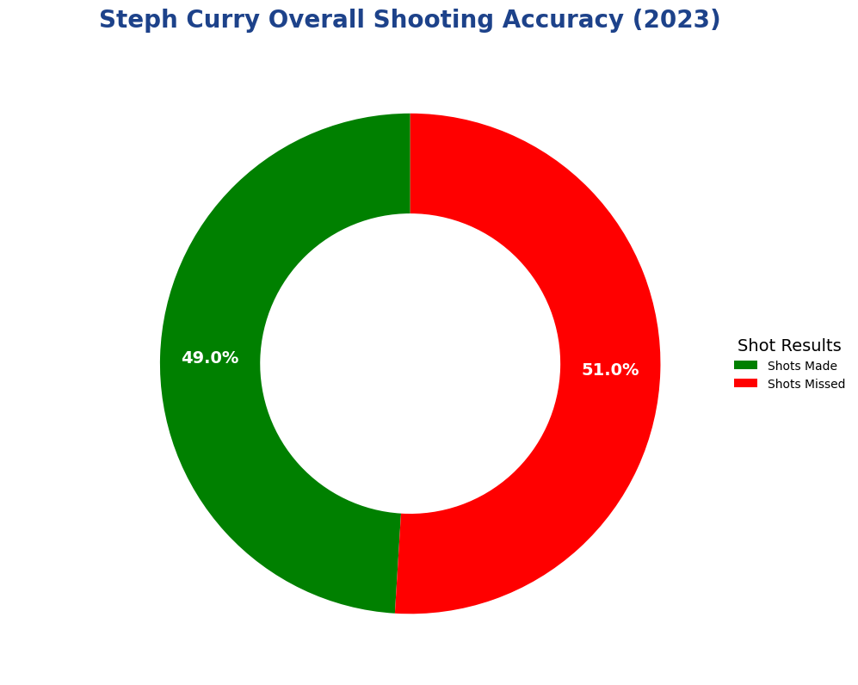
General Performance

Slide 5
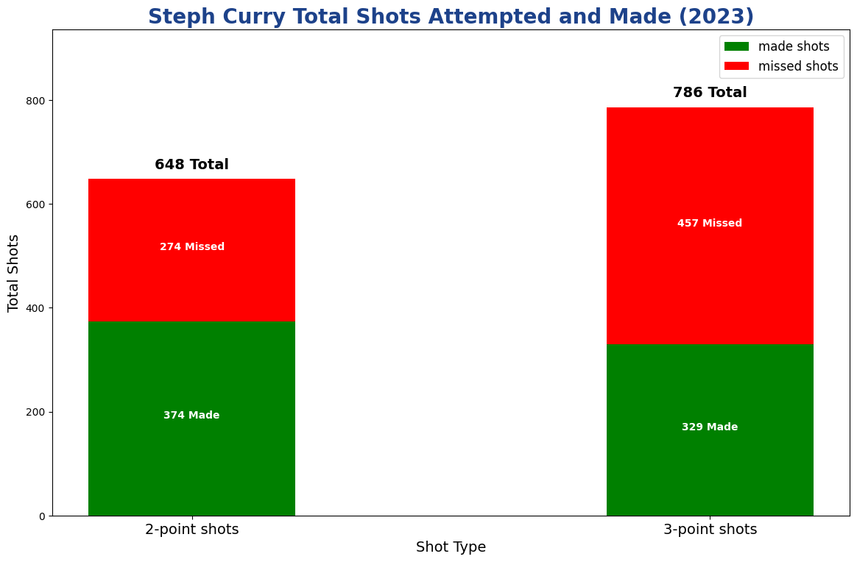
General Performance (Cont.)

Slide 6
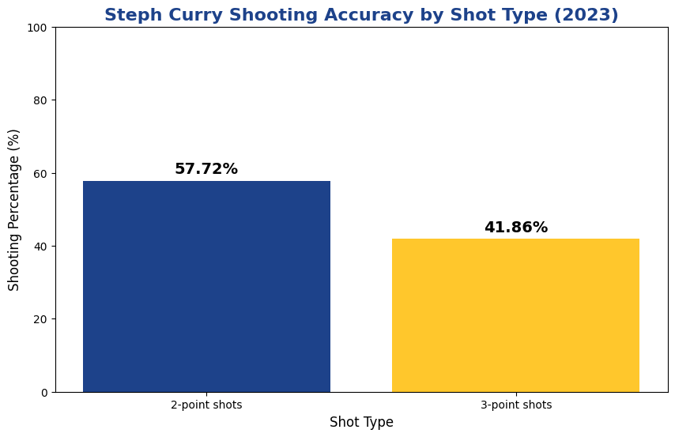
General Performance (Cont.)

Slide 7
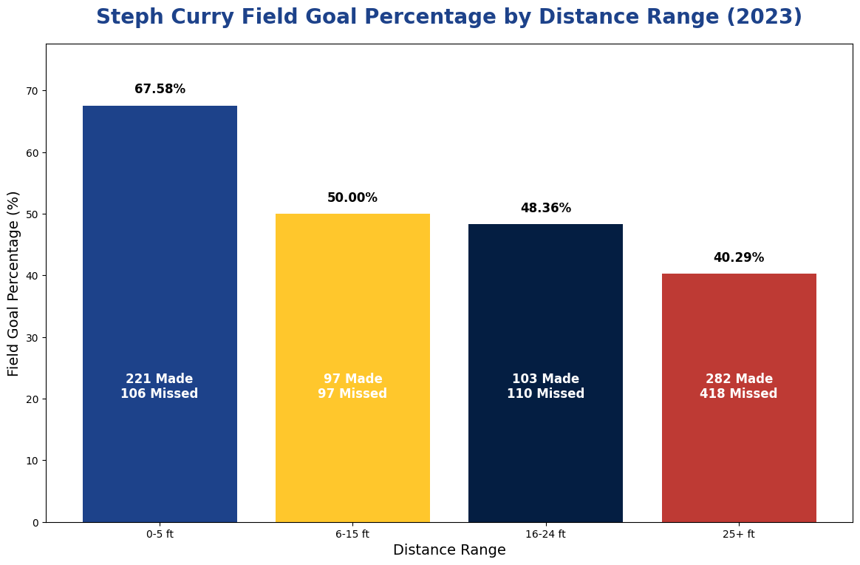
Shot Distance and Efficiency

Slide 8
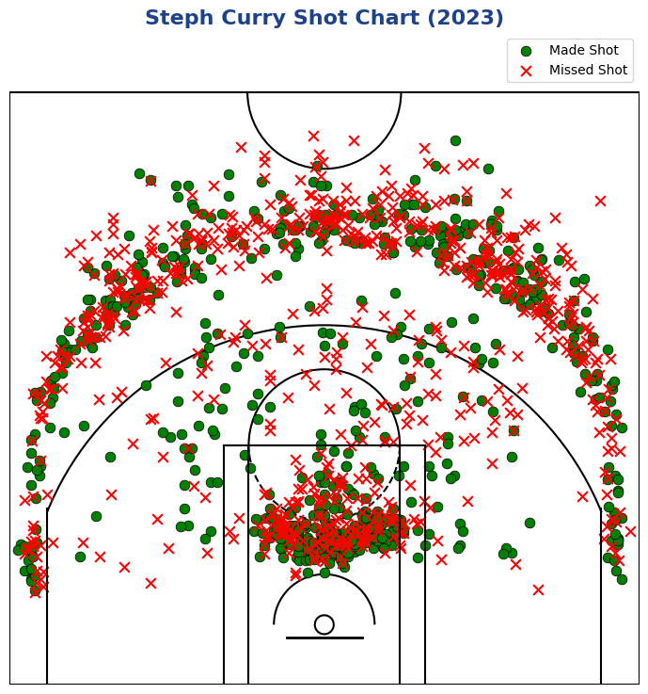
Shot Location Analysis

Slide 9
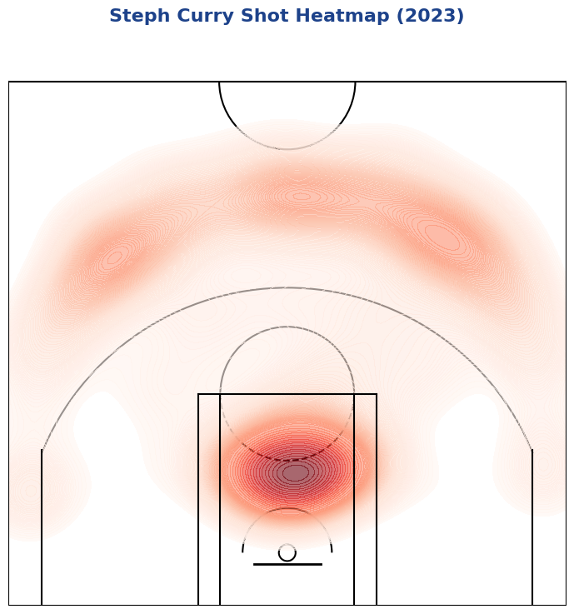
Shot Location Analysis (Cont.)

Slide 10
Conclusion
Compared to the 2021-2022 Season
Steph Curry played in more games (64) compared to 2022-2023 Season
Steph Curry Shooting Percentages
2-point – 56.9%
3-Point – 38.0%
Despite playing less games in the 2022-2023 season
Steph Curry Appeared to be more efficient in the 2022-2023 season
Steph Curry appears to be more efficient inside 0-5 feet (2023)
This correlates with Steph’s total shots inside 5 feet
Further, the heatmap confirms his Efficiency
Steph Curry is a strong scorer in the NBA
Despite increasing age
Steph Curry should continue to be top option on plays
Steph Curry should continue to shot from all reasonable ranges

